Slide 1
Java GUI Drag &Drop Exercise 1
Next Robotics

Slide 2

Todo: Create a new project named “JavaAreaCalculatorGUI”

Slide 3
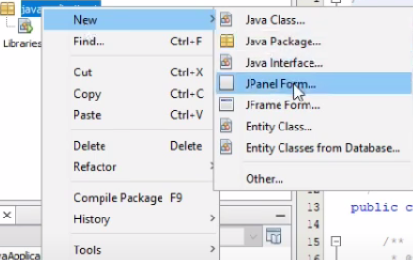
Todo: Right click on the package and create a new JFrame Form

Slide 4
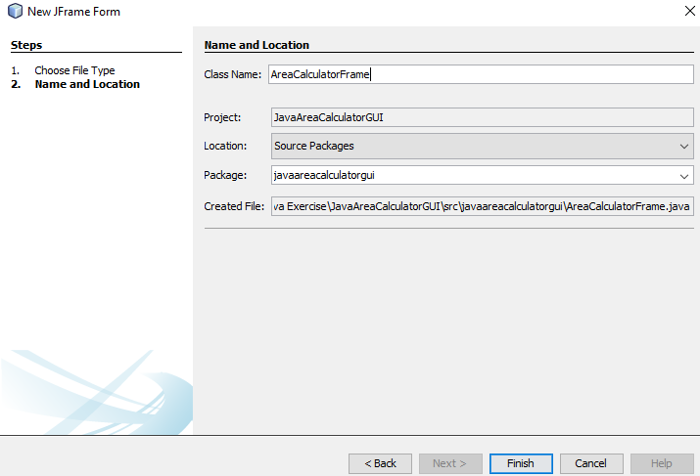
Todo: give the name of the Jframe Form class “AreaCalculatorFrame”

Slide 5
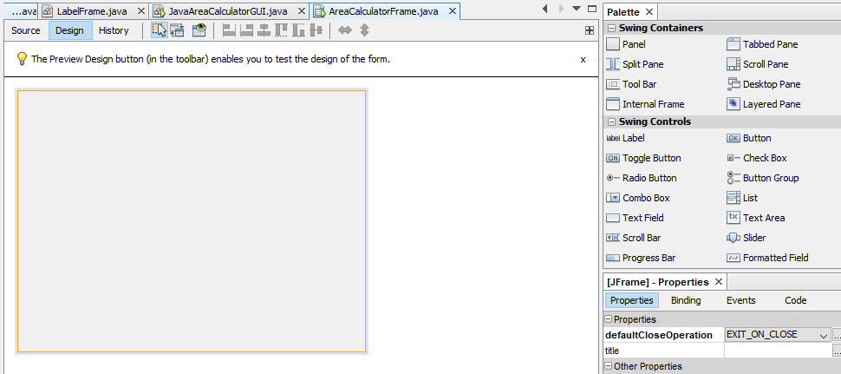
Now You End up with a blank Frame and a drag and drop items on the left.

Slide 6
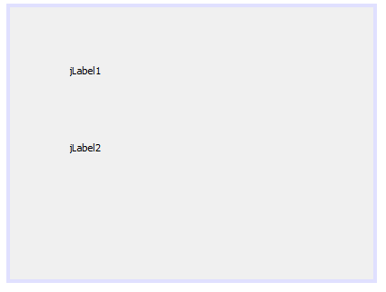
Todo: Drag and drop 2 “Label” items form “Swing Controls” in the left

Slide 7
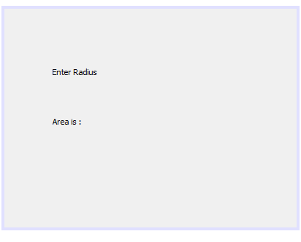
Todo: Try to edit the labels by double clicking inside it (or.. Right click then “Edit Text”)

Slide 8
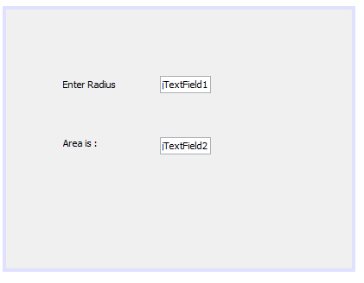
Todo: add two ‘TextField’ items form the Swing Controls

Slide 9
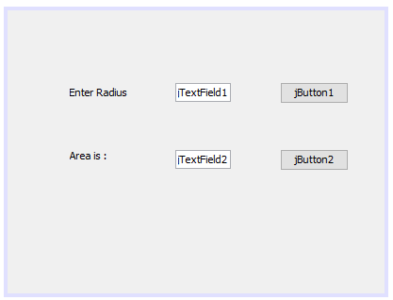
Todo: add two buttons form the Swing Controls section

Slide 10
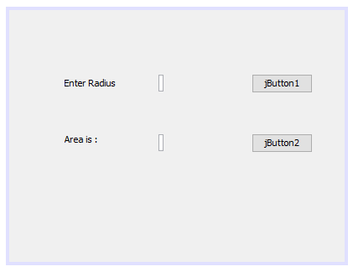
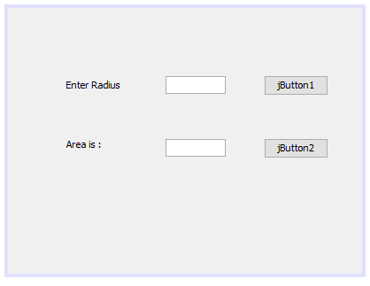
Todo: Rename the text fields with blank text. You can set the size of the field with end points on the box.

Slide 11
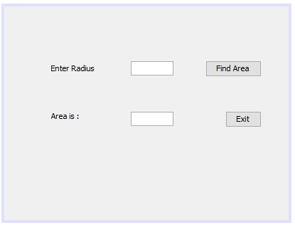
Todo: Rename the buttons

Slide 12
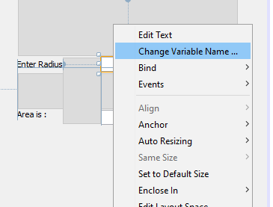
Todo: change the variable name of the two text boxes
To edit the variable name of a text field, you should right click on it and select ‘Change Variable Name’
Change the first text field variable name to “textField1”
Change the second text field variable name to “textField2”

Slide 13
Todo: Change the variable name of the two buttons
The variable name of “Find Area” button - ‘areaButton’
The variable name of “Exit” button – ‘exitButton’

Slide 14

Todo: double click on “Find Area” button to go to the source code that is generated by the IDE.

Slide 15
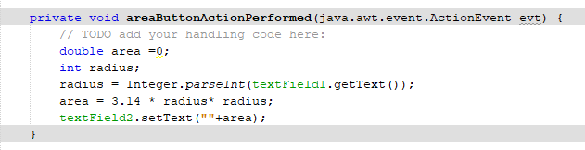
Todo: Write the following code in its method

Slide 16
Todo: double click on “Exit” button to go to the source code that is generated by the IDE. And add the code below in to its method

Slide 17
Todo: run the program
To run the GUI you built, you should right click on the “AreaCalculatorFrame.java” form projects view and select ”Run File”

